Slide 1


Help Yourself
The target group
Age groups from
14 to 18 years old
Preparation
Ayman Shukry Abd El-Razek Ahmed
Psychology teacher
Next
2024
Notes:
(Help Yourself)

Slide 2
…. Standards
1 - Familiar with the subject of psychology characteristics and style of study
2 - estimated value of psychology as a science, and aware of his status within the system of the other sciences.
3 - only aware and practiced scientific methods of research and the study of psychological phenomena using modern techniques.
4 - understands itself and its potential cost (biological and physiological bases of behavior - the motives and emotions - psychological and biological growth - cognitive processes - different intelligences - .... etc.)
5 - gaining skills and self-learning skills, scientific thinking, critical, creative, beyond the knowledge ......
6 - earns positive personal attributes and will be coming to life.
7 - understand and accept each other and deal with it efficiently to achieve greater harmony and happiness.
8 - appreciates and respects individual differences among people.
9 - estimated the importance of community and society, seeking to achieve a psychological compatibility.
Previous
Next
Notes:
Standards

Slide 3

General goals of psychology 1 Multi introduce students study psychology as the scientific study of behavior is committed to scientific disciplines, both in the objectives, research methods or topics of study. 2 introduce students to the fields of psychology, including basic and applied allows him interest in this science on the one hand and take advantage of it to achieve the other hand, applications of psychology in the scientific aspects of life. 3 student acquisition of scientific knowledge, which help him to understand his behavior and the behavior of others, both in terms of emotional, mental or social with the opportunity for the student to choose the credibility of those academic knowledge of everyday situations. 4 students acquire the skills of mental, emotional and behavioral, which allows him to take advantage, which he learned in modifying the behavior and development.
Previous
Next
Notes:
General goals of psychology

Slide 4
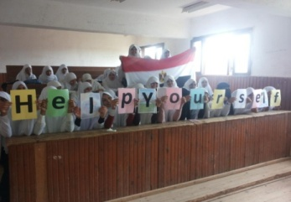
The General Objectives of the Project
1-The development of a sense of responsibility among students in support of his progress
2- Adopt positive behaviors toward others and society 3- Encouraging self-learning among students 4- Development of observation and conclusion among students 5- The development of the spirit of cooperation among students through cooperative learning
Uses information and communication technology in order to 6achieve the learning objectives and
implementation . 6- Activities and display the results and analysis
-7inks between the concepts of substance and concepts of other materials. -8 Shows the relationship between topics and themes article other materials. -9 Article uses the principles in solving the problems belong to other subjects. -10 Classified data and information into categories homogeneous and trains students on it. - 11 analyzes the information available and trains students on it. - 12 between the parts compose the non-correlated in every meaningful. - 13 infer new knowledge from the information available to him. - 14 think flexibly and accept the new. - 15 encourages students to critique the familiar and non-inherited with data delivery. - 16 helps students to discover contradictions.
Previous
Next
Notes:
The General Objectives of the Project

Slide 5
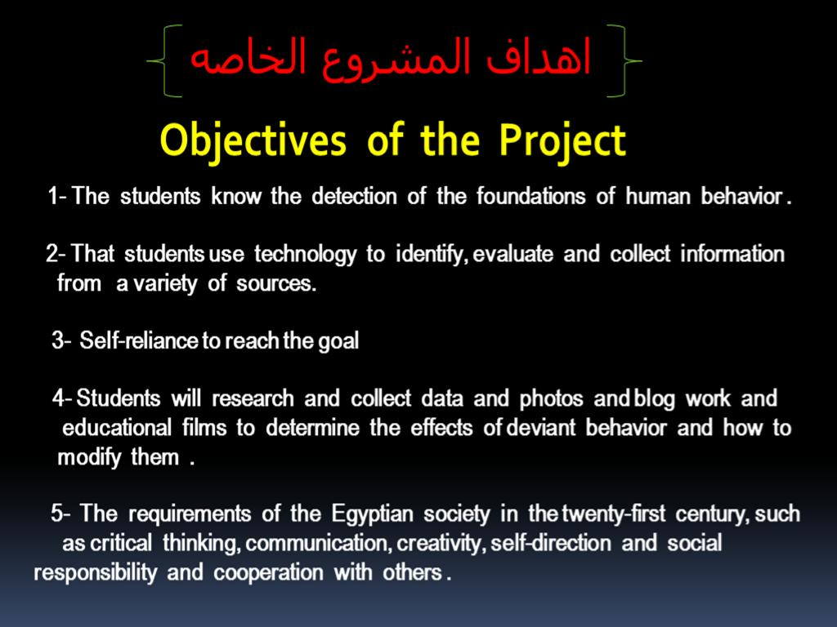
Previous
Next
Notes:
Objectives of the Project

Slide 6
Project Description
The human behavior as a result of a range of influences if we want to study human behavior in the position of the positions we had to look at the characteristics of the situation outside and look at the facts concerning the composition of biological and then look at the past history of the person who created the character, then the current state of motivation. Any look at the motives of this behavior in this situation and these four elements should be viewed as complementary to that if separated from some lost its meaning. In doing so we can work on modifying the behavior of society for the better.
Before we begin commissioned the students to work in the project (Help Yourself) is the work of: -
1- Preliminary testing to demonstrate the different cognitive levels of students.
2- View the presentation to gauge the needs of students and to distribute them through the roles of the project in accordance with the knowledge and skill levels of different students.
3- The work of a questionnaire to collect information on the topic of the unit students while working in the project.
4- Guide students to the work of self-assessment, which would be required to work themselves through.
5- Guest ongoing work of the students during the work on the project.
Previous
Next
Notes:
Project Description

Slide 7


Action Steps in the Project
1 1- Implementation of tribal activity. 2- Distribution to students (5) cooperative work groups. 3- Distribution of tasks to groups. 4- Commissioning groups to distribute roles and tasks and work timeline for the first stages of the work. 5- Showing sources students can get information from them safely.
Next
Important Notes: 1 should be documented source attributed to the hand of the supplied information or image
2 Make sure you get an official letter from the school administration when reviewing the information through the Government concerning the maintenance of libraries.
Previous
Notes:
Action Steps in the Project
Help Yourself

Slide 8
Tour virtual Classrooms ( VCT )
Images Virtual Classrooms
Introduction of the Project
Project Background and Objectives
Microsoft Innovative Teachers
Previous
Next
Notes:
Tour virtual Classrooms
- VCT

Slide 9
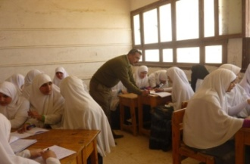
Distribution of Tasks Boil Groups
Group A: doing a presentation with Microsoft PowerPoint program The two students search for the required information (textbook - Library - Internet) the rest of the group are designing slides. The leader of the group to follow up the activities of the students in charge of this task, and the distribution of tasks among themselves, and follow the progress or crashes his colleagues and overcome the obstacles in front of them, and then review the offer Progressive for this group according to the standards of the petition, which focuses on the integration of technology in the supply and the extent of student learning and the possibility of implementation in the classroom, has been guide students and guide them to some sites that help them make the most of the possibilities of the program Microsoft PowerPoint, have been adjusted width according to the knowledge and new skills that have been learned, it was agreed with the leader of the group on the presentation will be Progressive colleagues used assessment tool for the offer Progressive students will prepared to identify strengths and weaknesses and strengthened and try to strengthen them. The second group is doing research to gather and organize information after the seminar, and to implement it should proceed with the following steps: Discuss some of the important points about the behavior and motivations and how to employ them in the progress of society and the best methods available. Discuss ways and means of access to the information related to the unit and the skills of the unit and the work of a special project of the problem of the problems (pollution) Research Methods (search engines and how to use it - how to insert an image and voice) The two students search for the required information (textbook - Library - Internet) and a compilation E.mail students in a document. The third group is doing a publication using Microsoft word program by performing the following steps: Preparing students to use Microsoft word program and know for the program. The two students search for the required information (Library - Internet ( The rest of the group are designing a publication and writing.
Previous
Next
Notes:
Distribution of Tasks Boil Groups

Slide 10
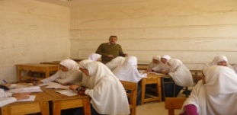
Continued Distribution of Tasks
Group Fourth : set design model for the behavior and motivations: Where members design model and display the results and go for a trip to the Palace of Culture of the province to inform students on references and important books project (Help Yourself). The design work or declaration of a special project. And assigns them to the proportion of the work of statistical behavior modification after completion of the project for the separation of school and out of school. Group Fifth : research group on the Internet. Where members searching for answers to questions put forward by to confirm and evaluate the information collected during the symposium and to obtain additional information and strengthen images and video files through search engines to easily search and share resources and save And a brief presentation about the work of) behavior and motives), and then discuss the worksheets with the students, taking into account the priorities and some of which the most important are: Focus on the content of the unit and employ high-tech possibilities for writing software Microsoft word. Safety language and clarity of images and shapes. Collaboration with colleagues in the development of the brochure. Supervision of the students during the implementation of the brochure and provide any assistance needed by the students. Preparation of an assessment tool for students brochure and application. Do feed due to the students by identifying some of the concepts and skills that did not gain is acceptable.
Next
Notes: Commissioning groups to distribute roles and tasks and work timeline for the initial stages of their effort to work for the private -1 2 Students can submit any appropriate additions of their creation 3 contribute to educate individuals on the use of appropriate and optimal behavior and employ their behavior and motives in the progress of society and the paper.
Previous
Notes:
Continued Distribution of Tasks

Slide 11
Distribution of Roles and Distribution of Tasks
Spokesman | Researcher | Author | Commander | Role | Distribution Roles
 |  |  |  | Name
Computerization of data using MS PPT , MS Excel, MS WORD. | Review Official bodies or correspondent. | Review Official bodies or correspondent | Search on the net | Task | Distribution Tasks
 |  |  |  | Contact Person
Previous
Next
Notes:
Distribution of Roles and Distribution of Tasks

Slide 12
Timeline for the Project (Help Yourself)
Third Meeting | Second Meeting | First Meeting
1-Management discussion about the questions surrounding the project. 2-Provide feedback. 3-Integration of technology. | 1-The work of a blog. 2-Play the roles of effective research skills 3-Monitoring individual work. 4-Short lessons on the use of worksheets. 5-Conferences with groups. | 1-Provide project scenario (Help Yourself). 2-Assess the needs of the students. 3-Composition of project teams (Help Yourself)
Sixth Meeting | Fifth meeting | Fourth meeting
1-Give the presentation total 2-The presence of the administration, teachers and parents. | 1-Election of Committee of groups 2-Presentation to prepare total | 1-The preparation of the presentation. 2-Prepare for the web site. 3-The preparation of the publication.
Previous
Next
Notes:
Timeline for the Project (Help Yourself)

Slide 13
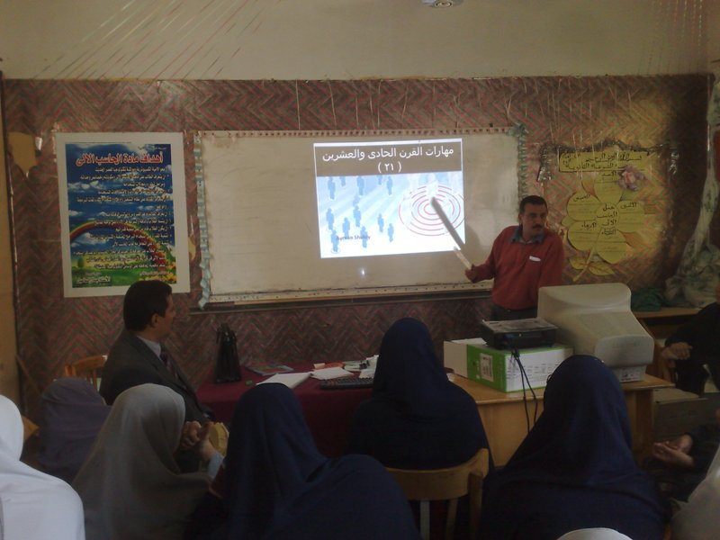
In the End, Costing Students Presented Their Work Presentations And Publications To Their Colleagues From Other Classrooms
Exit
Previous
Notes:
The End

